Slide 1

Why do we need constructors?
Member functions are used to initialize private variables of objects.
Eg:- x.getdata(100, 11.22);
But, these functions cannot be used to initialize the member variable at the time of creation of their objects.
Solution to this problem is solved by use of constructors.
“Constructors are special member functions which enables an object to initialize itself when it is created”. This is known as automatic initialization of objects.

Slide 2
Constructors
A constructor is a special member function whose task is to initialize the objects of its class at time of their creation.
It is special because its name is the same as the class name.
The constructor is invoked whenever an object of its associated class is created.
It is called constructor because it construct the values of data members of the class.

Slide 3
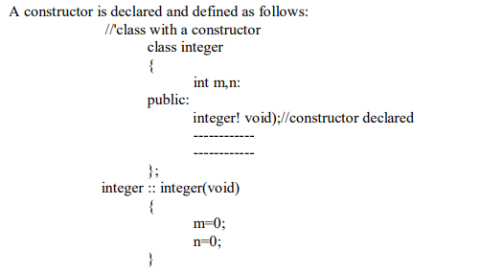
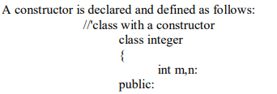

Slide 4
When a class contains a constructor like the one defined above it is guaranteed that an object created by the class will be initialized automatically.
For example:-
Integer int1; //object int 1 created
This declaration not only creates the object int1 of type integer but also initializes its data members m and n to zero.
There is no need to write any statement to invoke constructor function as we do with the normal member function. In case of normal function, we invoke this function for each of objects separately. This would be very inconvenient, if these are a large number of objects.

Slide 5
The constructor functions have some characteristics:-
They should be declared in the public section .
They are invoked automatically when the objects are created.
They don't have return types, not even void and therefore they cannot return values.
They cannot be inherited , though a derived class can call the base class constructor .
Like other C++ function , they can have default arguments,
Constructor can't be virtual.
An object with a constructor can't be used as a member of union.
They make implicit calls to operators new and delete when memory allocation is required.

Slide 6
Default Constructor
A constructor that accept no parameter is called the default constructor. The default constructor for class A is A :: A( ).
If no such constructor is defined, then the compiler supplies a default constructor .
Therefore a statement such as :-
A a ;//invokes the default constructor of the compiler to create the object "a" ;

Slide 7
Example of default constructor:
class abc
{
private:
char nm[];
public:
abc ( )
{
cout<<”enter your name:”;
cin>>nm;
}
void display( )
{ cout<<nm; }
};
int main( )
{
abc d;
d.display( );
getch( );
return(0);
}

Slide 8
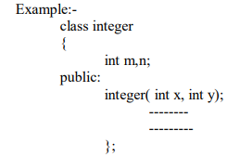
PARAMETERIZED CONSTRUCTOR
The constructors that can take arguments are called parameterized constructors.
Using parameterized constructor we can initialize the various data elements of different objects with different values when they are created.

Slide 9

the argument can be passed to the constructor by calling the constructor
implicitly.
integer int 1 = integer(0,100); // explicit call
integer int 1(0,100); //implicit call

Slide 10
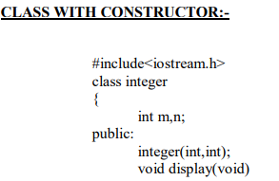
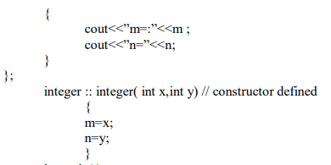

Slide 11
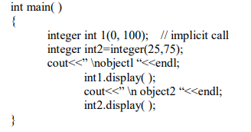
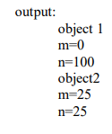

Slide 12
Constructor function can also be defined as inline.
Class integer
{ int m , n;
Public:
Integer (int x, int y) //inline constructor
{
m=x;
n=y;
}
---
};

Slide 13
Parameter of constructor can be of any type except that of class to which it belongs.
Class A
{
---
Public:
A(A); //illegal
};

Slide 14
A constructor can accept a reference to its own class as parameter.
Class A
{
---
Public:
A(A&); //valid, this is called copy constructor
};

Slide 15
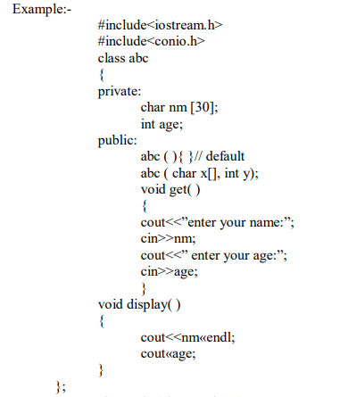

Slide 16
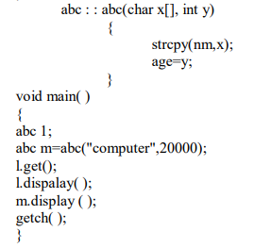

Slide 17
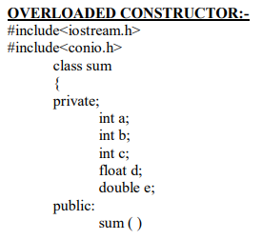
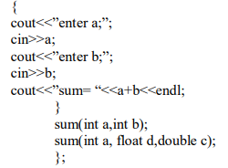

Slide 18
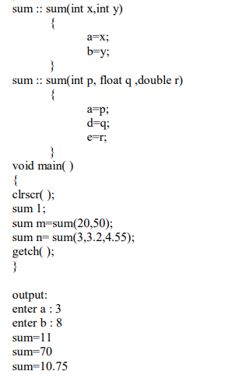

Slide 19

COPY CONSTRUCTOR
A copy constructor is used to declare and initialize an object from another object. Example:-
the statement
integer 12(11);
would define the object 12 and at the same time initialize it to the values of 11.
Another form of this statement is : integer 12=11;
The process of initialization through a copy constructor is known as copy initialization.

Slide 20
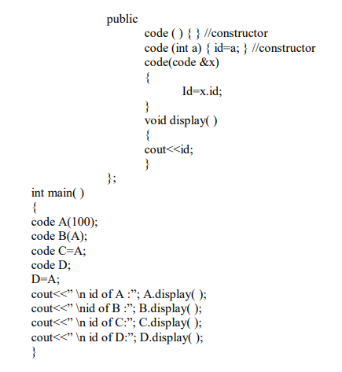

Slide 21
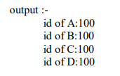

Slide 22
DYNAMIC CONSTRUCTOR
The constructors can also be used to allocate memory while creating objects .
This will enable the system to allocate the right amount of memory for each object when the objects are not of the same size, thus resulting in the saving of memory.
Allocate of memory to objects at the time of their construction is known as dynamic constructors of objects.
The memory is allocated with the help of new operator.

Slide 23
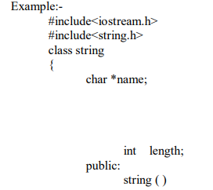
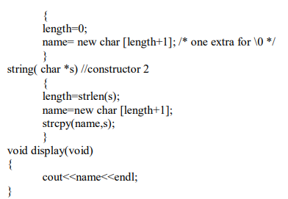

Slide 24
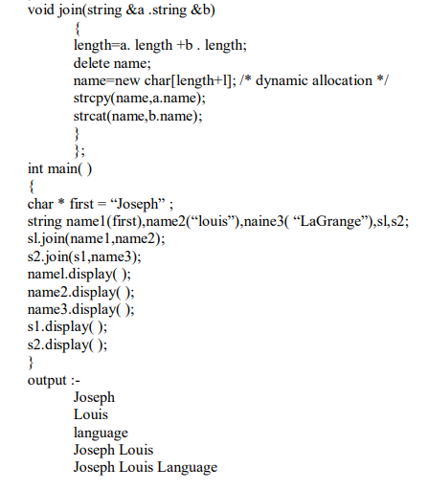

Slide 25
DESTRUCTOR
A destructor, us the name implies is used to destroy the objects that have been created by a constructor. Like a constructor, the destructor is a member function whose name is the same as the class name but is preceded by a tilde.
For Example:- ~ integer( ) { }
A destructor never takes any argument nor does it return any value. It will be invoked implicitly by the compiler upon exit from the program to clean up storage that is no longer accessible. It is a good practice to declare destructor in a program since it releases memory space for future use.
Delete is used to free memory which is created by new.

Slide 26
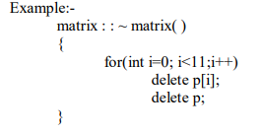
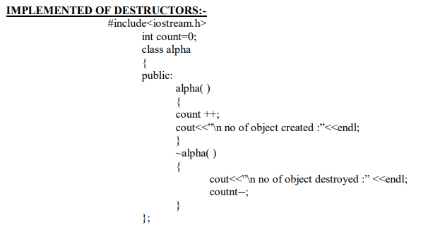

Slide 27
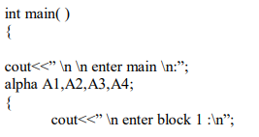
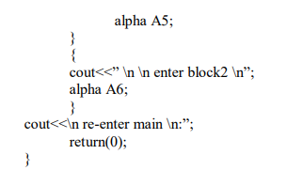

Slide 28
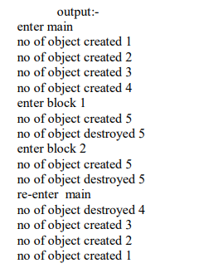

Slide 29
THANK YOU

